Slide 1
Amazon SNS
Lecturer: Ngo Huy Bien
Software Engineering Department
Faculty of Information Technology
University of Science
Ho Chi Minh City, Vietnam
nhbien@fit.hcmus.edu.vn

Slide 2

Objectives

Slide 3

Contents

Slide 4

References

Slide 5
Amazon Simple Notification Service
https://aws.amazon.com/sns/
Fully managed Pub/Sub service for A2A (application-to-application) and A2P (application-to-person) messaging.
A2A provides high-throughput, push-based, many-to-many messaging between distributed systems, microservices, and event-driven serverless applications.
These applications include Amazon Simple Queue Service (SQS), Amazon Kinesis Data Firehose, AWS Lambda, and other HTTPS endpoints.
A2P functionality lets you send messages to your customers with SMS texts, push notifications, and email.

Slide 6
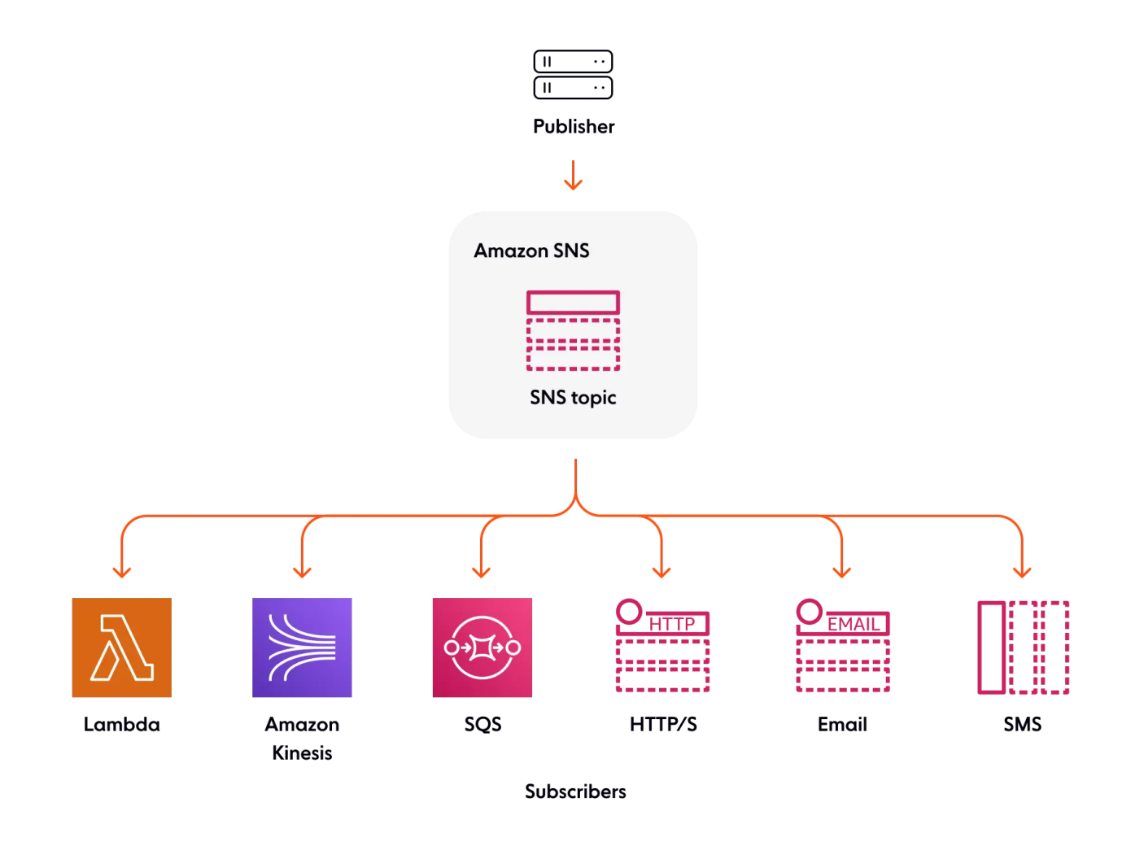
Distributed Publish/Subscribe Solution

Slide 7
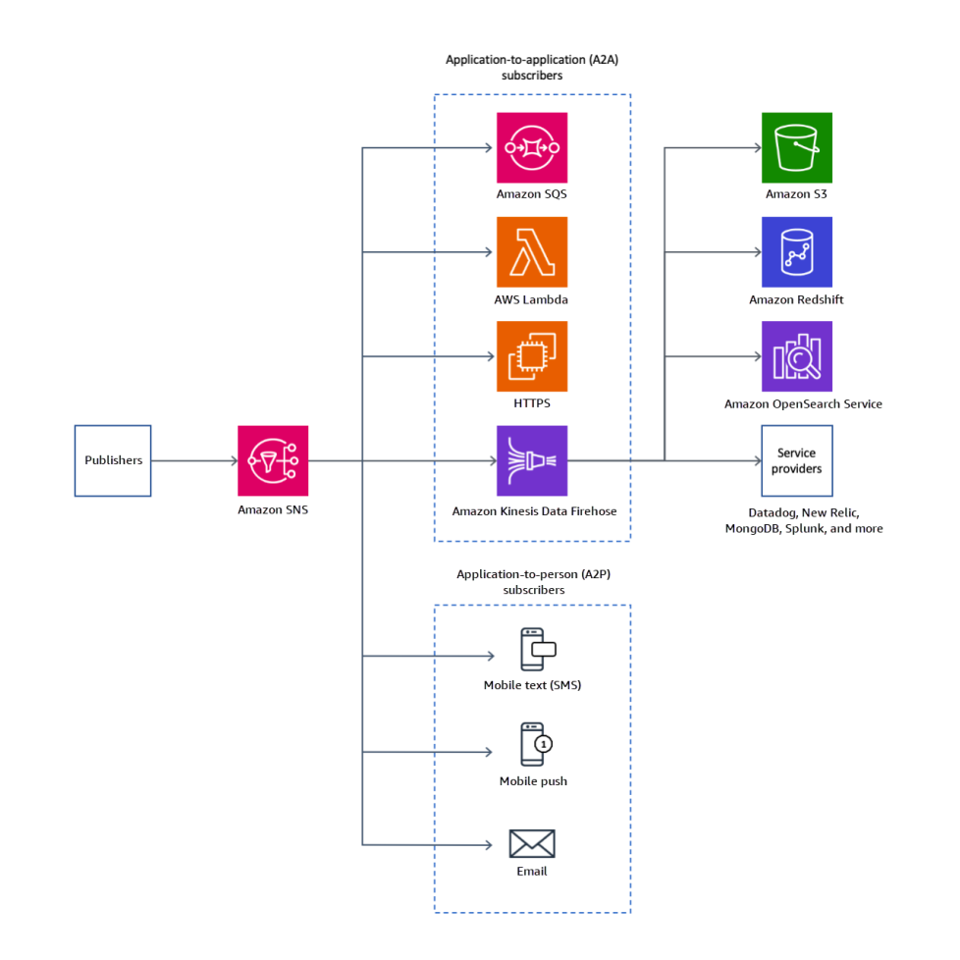
A2A and A2P

Slide 8
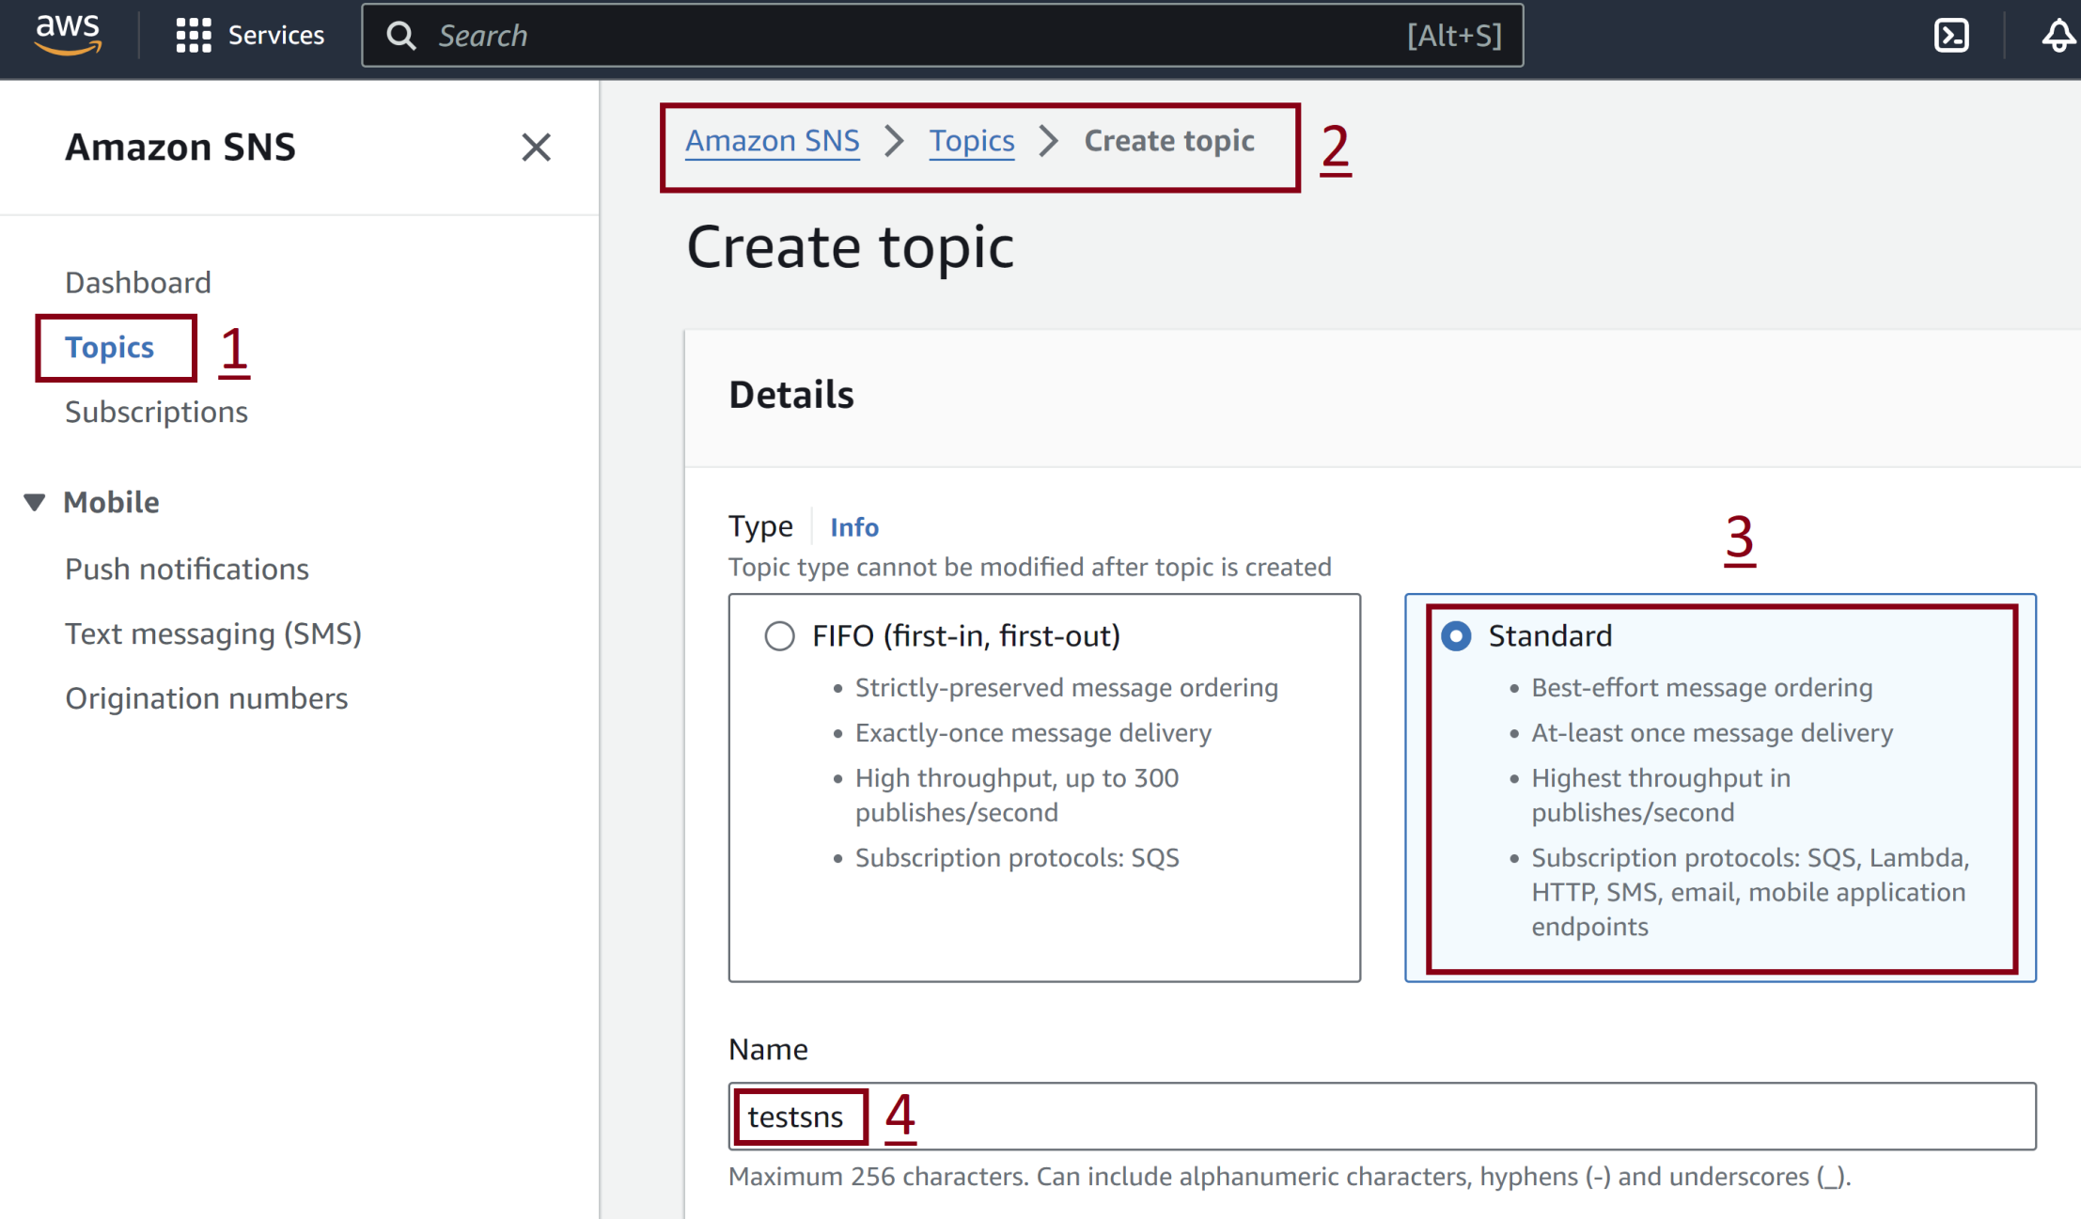
1. Create SNS Topic

Slide 9
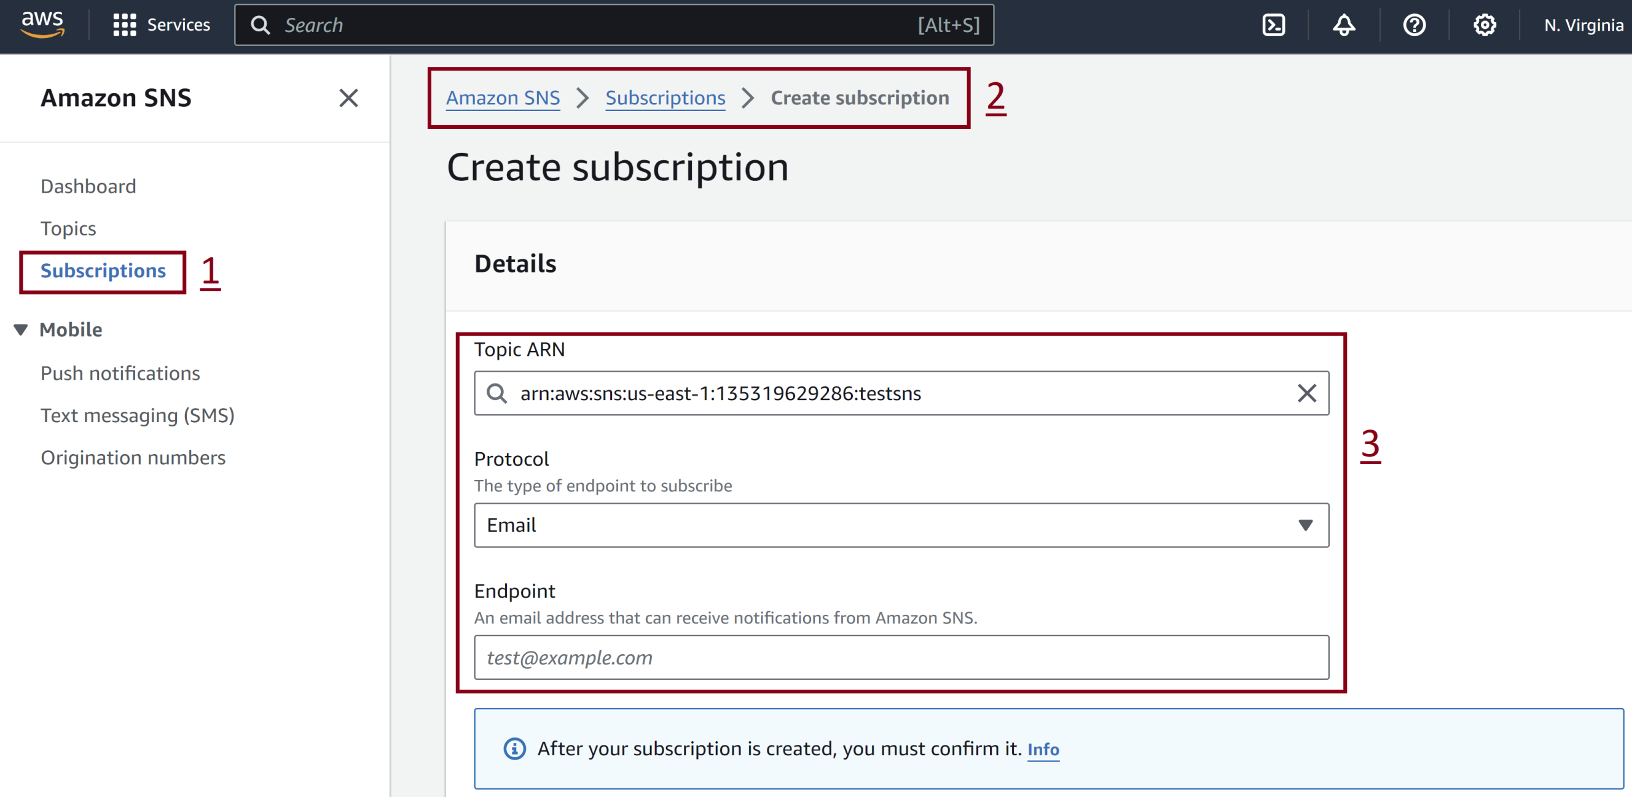
2. Create SNS Subscription

Slide 10
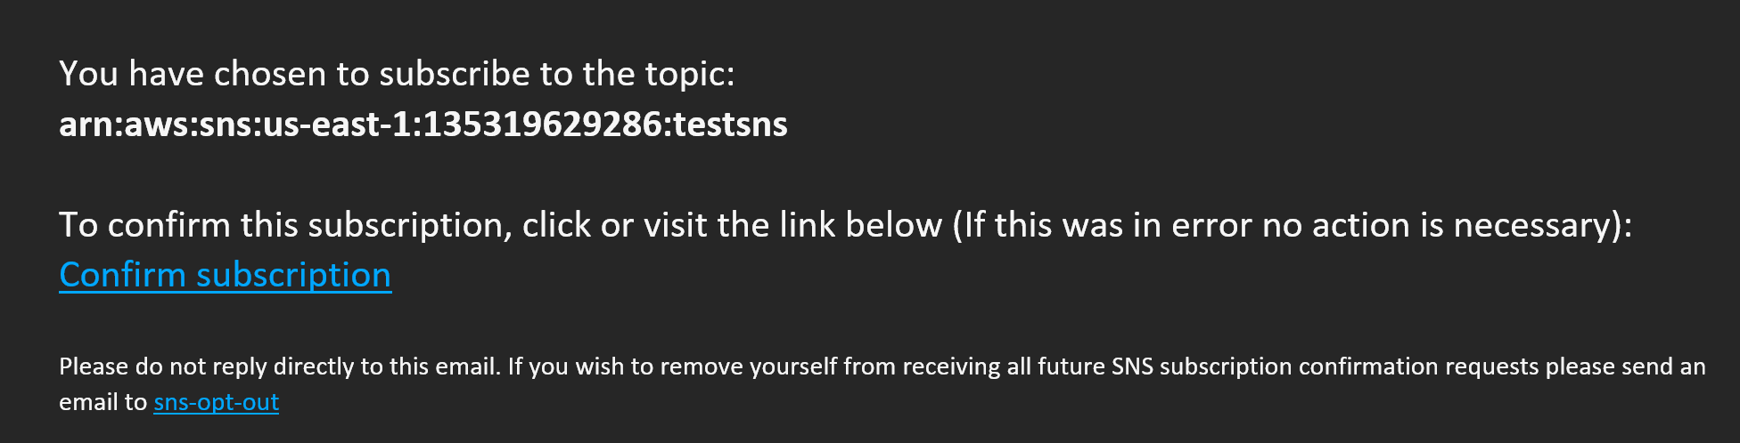
3. Confirm Subscription

Slide 11
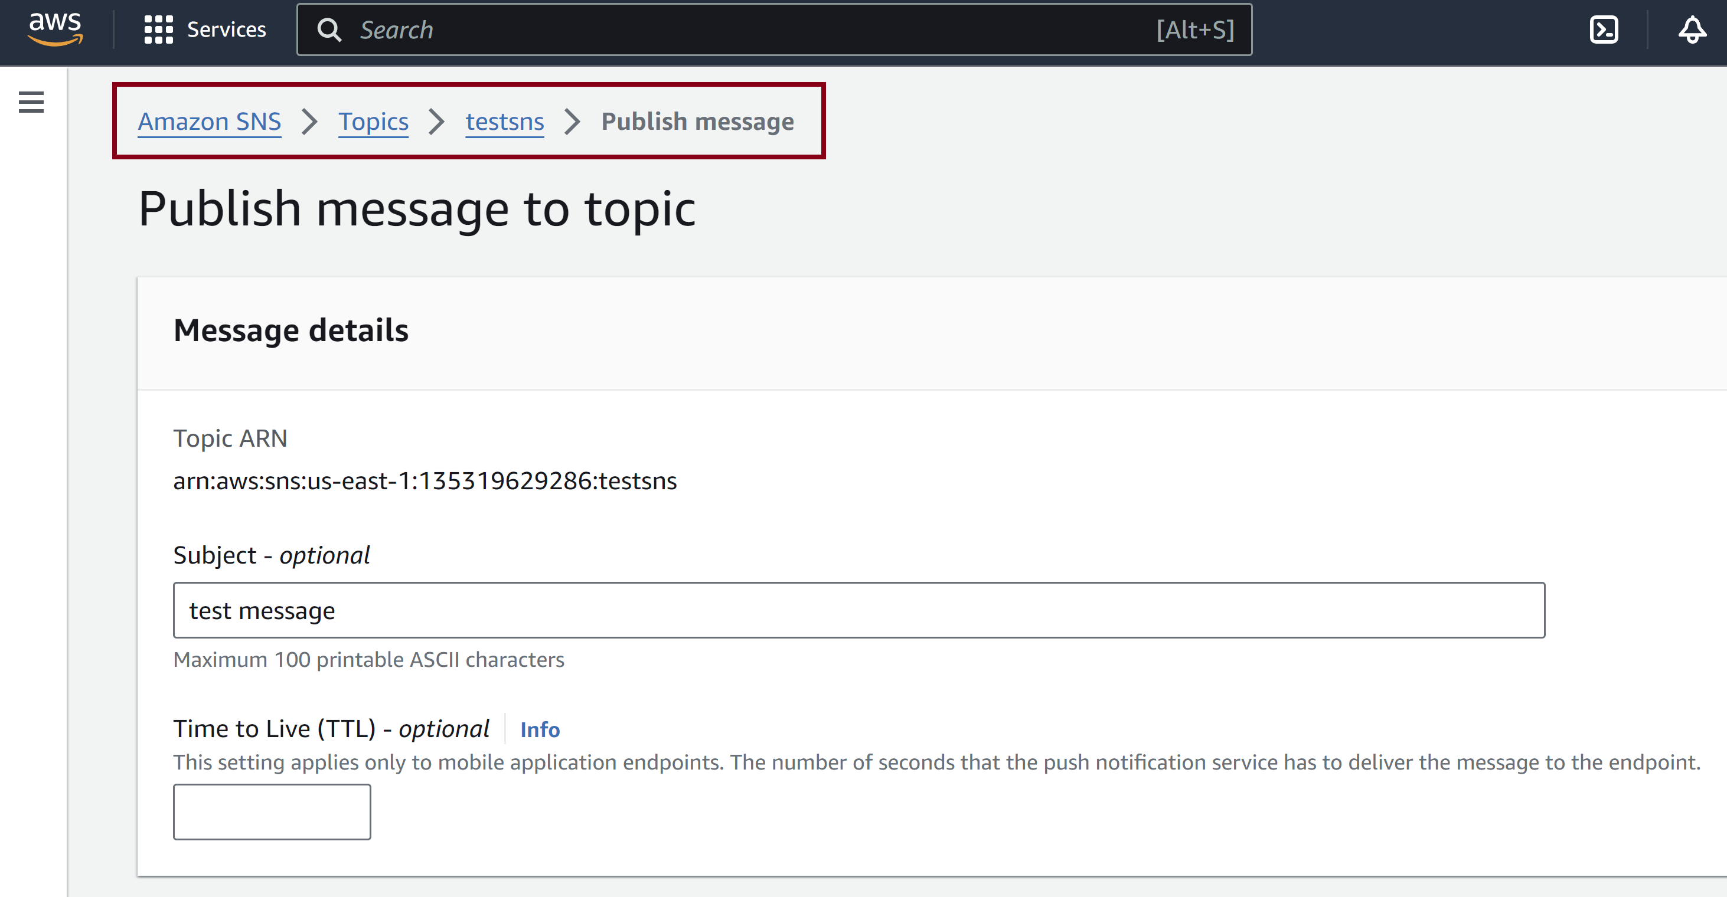
4. Publish Message

Slide 12

Thank You & See You Again

